Slide 1
Introduction to CUDA
Section 1

Slide 2
Overview of CUDA

Slide 3
GPU Programming
General-purpose parallel processors
Thousands of cores
Specialized for data parallel processing

Slide 4
GPU Programming (Continued)
Large speedups for many workloads:
Deep learning
Image processing
Linear algebra

Slide 5
Data Parallelism
Data is spread across cores
SIMT: Single Instruction, Multiple Thread
Works well for large array or matrix operations

Slide 6
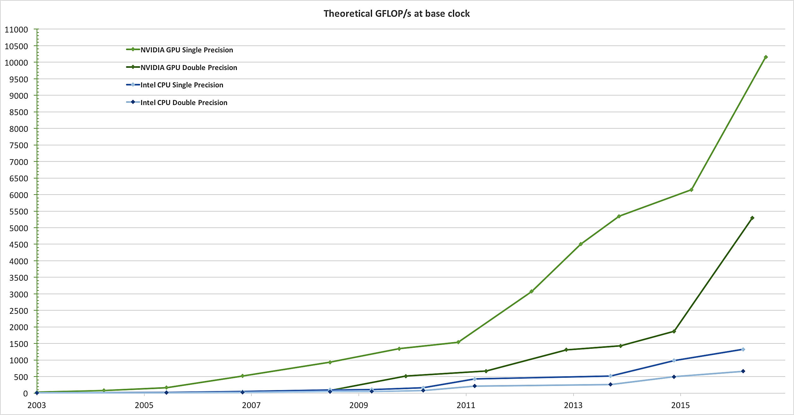
Comparison of Floating Point Speed

Slide 7
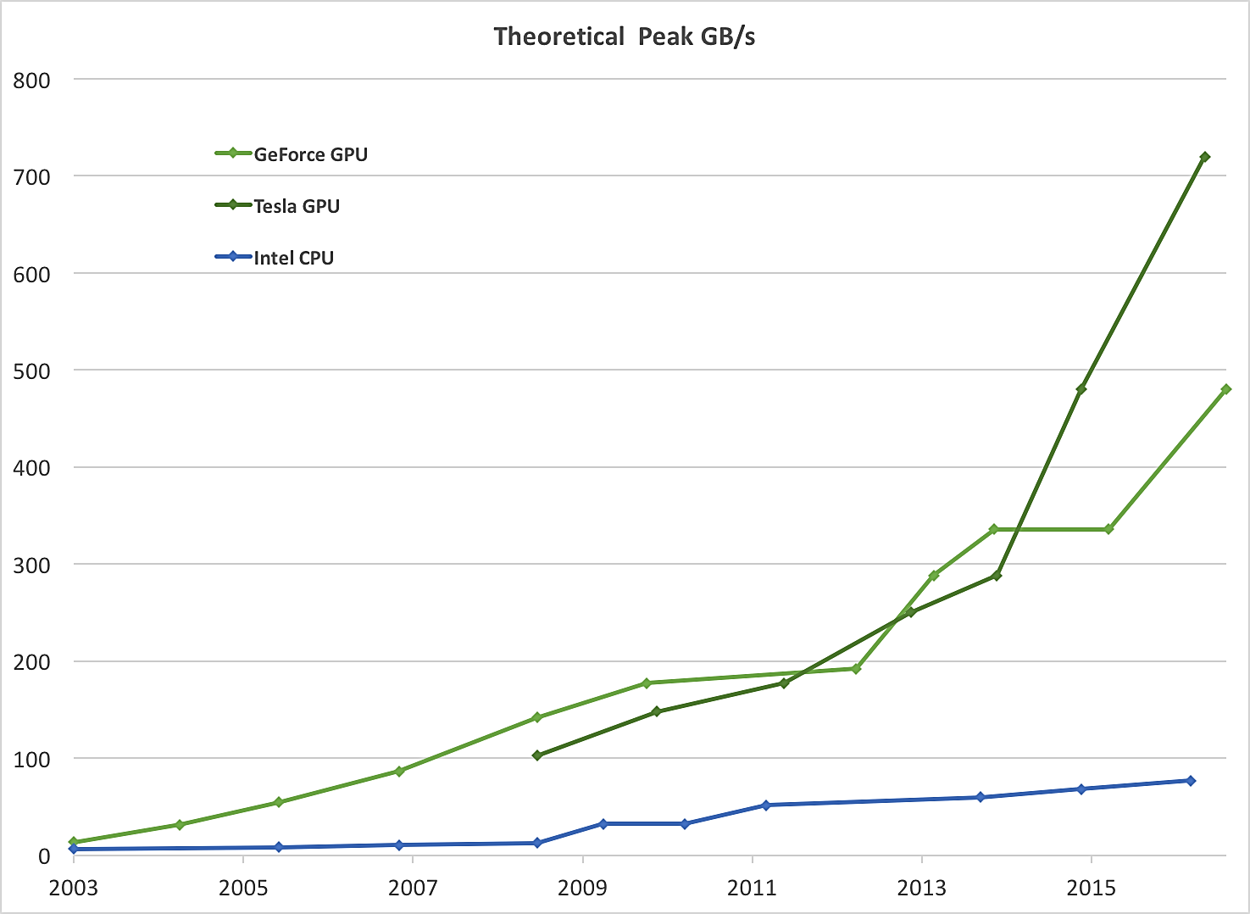
Comparison of Memory Bandwidth

Slide 8
CUDA Programming
General-purpose programming model
Scales to thousands of parallel cores
Easy learning curve for C++ programmers

Slide 9
The CUDA Toolkit
NVCC compiler
Debuggers
NVIDIA Visual Profiler
Libraries
Documentation

Slide 10
Installing the CUDA Toolkit on Windows
Next Video

